Slide 1
Unit 8: Introduction to Transaction Processing Concepts and Theory [4 HRs]

Slide 2
Contents of the Unit
Introduction to Transaction Processing; Transaction and System Concepts, Desirable Properties of Transaction; Characterizing Schedules based on Recoverability; Characterizing Schedules based on Serializability

Slide 3
Introduction
A transaction is a collection of several operations on the database that appears to be a single unit from the point of view of the database user.
For example, a transfer of funds from one account to another account is a single operation from customer’s point of view but within the database system, however, it consists of several tasks.

Slide 4
Transaction Example
Operation (Money Transfer) | T1
Read balance of account A1 | Read(A1)
Subtract 20000 from A1 | A1 = A1-20000
Update balance of A1 | Write (A1)
Read balance of account A2 | Read(A2)
Add 20000 to A2 | A2 = A2+20000
Update balance of A2 | Write(A2)

Slide 5
SQL Representation
Update Account set balance = balance-20000 where accno = ‘A1’
Update Account set balance = balance+20000 where accno = ‘A2’

Slide 6
Read/Write Operations of Transaction
Basic unit of data transfer from the disk to the computer main memory is one block.
In general, a data item (what is read or written) will be field/record/block.
Read and write are two basic operations of transactions.

Slide 7
Read(X)
This transfers the data item X from the database to a local buffer belonging to the transaction that executed the read operation.
For this it performs following sequence of operations
Find the address of the disk block that contains item X.
Copy that disk item into a buffer in main memory
Copy item X from the buffer to the program variable named X

Slide 8
Write(X)
This transfers the data item X from the local buffer belonging to the transaction that executed the write block to the database.
For this it performs following sequence of operations
Find the address of the disk block that contains item X.
Copy that disk block into a buffer in main memory
Copy item X from the program variable named X into its correct location in the buffer
Store the updated block from the buffer back to disk

Slide 9
Desirable Properties of Transaction
To ensure the integrity of the data, the database system must maintain some desirable properties of the transaction.
These properties are known as ACID properties (Atomicity, Consistency, Isolation, Durability)

Slide 10
Atomicity
The atomicity property of a transaction implies that it will run to completion as an indivisible unit, at the end of which either no changes have occurred to the database or the database has been changed in a consistent manner.
The database keeps track of the old values off any database on which a transaction performs a write, and if the transaction does not complete its execution, the old values are restored to make it as though the transaction never executed.

Slide 11
Consistency
The consistency property ensures that any transaction will bring the database from one valid state to another.
It implies that if the database was in a consistent state before the start of a transaction, then on termination of the transaction, the database will also be in a consistent state.
During the execution of the transaction the state of the database become inconsistent. This state must not be visible to the users

Slide 12
Isolation
Each transaction is unaware of other transactions executing concurrently in the system.
This means in case of concurrent execution of transaction, execution of one transaction should not interfere the execution another transaction.
The isolation property of a transaction ensures that the concurrent execution of transactions results in a system state that is equivalent to a state that could have been obtained had these transactions executed one at a time in same order.

Slide 13
Durability
After a transaction completes successfully, the changes made to the database persist, even if there are system failures.
The durability property guarantees that, once a transaction completes successfully, all the updates that are carried out on the database persists even if there is a system failure after the transaction completes execution.

Slide 14
Transaction State
During the execution of transaction it passes through various states that are:
Active state
Partially committed state
Committed state
Failed state
Aborted State

Slide 15
Active State
In this state the transaction is being executed.
It is the initial state of transaction.
The transaction performs its READ and WRITE operations in this state.

Slide 16
Partially Committed State
When transaction executes its final operation, it is said to be in this state,
After execution of all operations, the database system performs some checks eg, consistency state of database.

Slide 17
Failed State
If any check made by database recovery system fails, the transaction is said to be in failed state, from where it can no longer proceed further.

Slide 18
Aborted State
If any of the checks fails and transaction reached in failed state, the recovery manager rolls back all its write operations on the database to make database in the state where it was prior to the start off execution of transaction.
Transactions in this state are called aborted.
Database recovery module can select either of the following operations:
Restart the transaction
Kill the transaction

Slide 19
Committed State
If transaction executes all its operations successfully it is said to be committed.
All its effects are now permanently made on database system.

Slide 20
Begin End-transaction Commit Transaction
Transaction
Abort Abort
Figure: State of transaction
Active
Partially Committed
Committed
Failed
Terminated

Slide 21
Why Concurrency Control is needed
Several problems can occur when concurrent transactions execute in an uncontrolled manner.
The Lost Update Problem
The Temporary Update (or dirty read) Problem
The Incorrect Summary Problem

Slide 22
Why Concurrency Control is needed
The Lost Update Problem : This problem occurs when two transactions that access the same database items have their operations interleaved in a way that makes the value of some data items incorrect

Slide 23
Why Concurrency Control is needed
The Temporary Update (or dirty read) Problem : This problem occurs when one transaction updates a database and then the transaction fails for some reason. meanwhile, the updated item is accessed (read) by another transaction before it is changed back to its original value.

Slide 24
Why Concurrency Control is needed
The Incorrect Summary Problem : If one transaction is calculating an average summary function on a number of database items while other transactions are updating some of these items, the aggregate function may calculate some values before they are updated and other after they are updated.

Slide 25
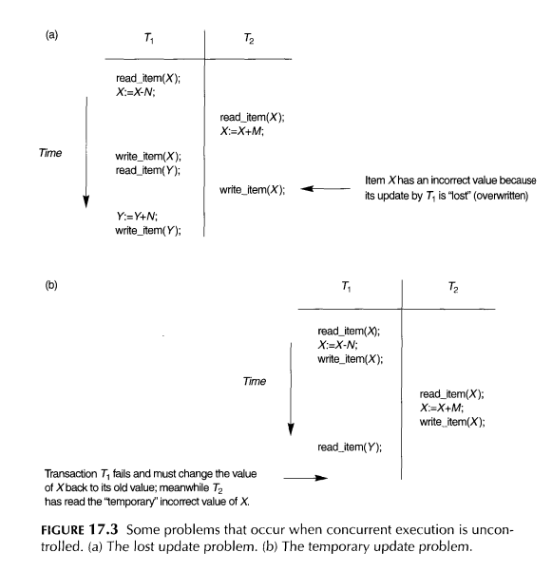

Slide 26
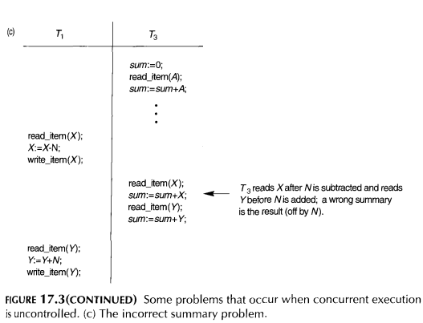

Slide 27
Schedules
When transactions are executing concurrently in an interleaved fashion, then the order of execution of operations from the various transactions is known as a schedules (history).

Slide 28
Schedule
A schedule S of n transactions T₁,T₂,…T_{n} is an ordering of the operations of the transactions subject to the constraint that, for each transaction T_{i} that participates in S, the operations of T_{i} in S must appear in the same order in which they occur in T_{i}.
However, that operations from other transactions T_{j} can be interleaved with the operations of T_{i} in S.
For the purpose of recovery and concurrency control, we are mainly interested in the read_item and write_item operations. A shorthand notation for describing a schedule uses the symbols r, w, c and a for the operations read_item, write_item, commit, abort respectively, appends as subscript the transaction id (transaction number) to each operation in the schedule.

Slide 29
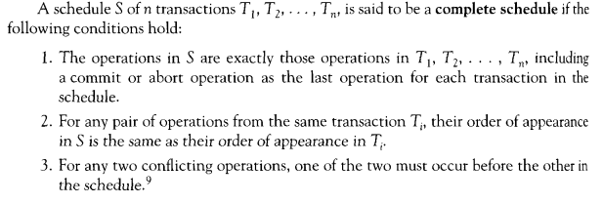
Schedule

Slide 30
Schedule
T₁ | T₂ | T₃
Read(X)
Write(X)
Commit
 | Read(Y)
 | Write(Y)
 | Commit
 |  | Read(Z)
 |  | Write(Z)
 |  | Commit

Slide 31
Schedule
A more common way in the technical literature for representing schedule is as follows:
S: R₁(X) W₁(X) com₁ R₂(Y) W₂(Y) com₂ R₃(Z) Z₃(Z) com₃

Slide 32
Characterizing Schedules Based on Serializability
The concept of Serializability of schedules is used to identify which schedules are correct when transaction executions have interleaving of their operations in the schedules.

Slide 33
Serial and non-serial Schedule
A schedule in which transactions are aligned in such a way that one transaction is executed first. When the first transaction completes its cycle then next transaction is executed.
Transactions are ordered one after other. This type of schedule is called serial schedule as transactions are executed in a serial manner.
In a multi-transaction environment, serial schedules are considered as benchmark.
The commit or abort of one transaction initiates the execution of the next transaction.

Slide 34
Serial and non-serial Schedule
Serial schedule limit concurrency if one transaction waits for I/O operation to complete, the CPU cannot be switched to some other transaction.
Hence serial schedules are considered unaccepted in practice.
A schedule where the operations from a set of concurrent transactions are interleaved is called non-serial schedule.
Although non-serial schedules are important to achieve efficient throughput in multi-user environment, they do not produce correct result always. The execution sequence of instructions in a transaction cannot be changed but two transactions can have their instruction executed in random fashion.

Slide 35
Serial and non-serial Schedule
This execution does not harm if two transactions are mutually independent and working on different segment of data but in case these two transactions are working on same data, results may vary.
This ever-varying result may cause the database in an inconsistent state.

Slide 36
Serial and non-serial Schedule
T₁ | T₂
Read(A)
A = A-50
Write(A)
Read(B)
B = B+50
Write(B)
 | Read(A)
 | Temp = A*0.1
 | A = A-temp;
 | Write(A)
 | Read(B)
 | B = B+Temp
 | Write(B)
Table: Serial schedule
T₁ | T₂
Read(A)
A = A-50
Write(A)
 | Read(A)
 | Temp = A*0.1
 | A = A-temp;
 | Write(A)
Read(B)
B = B+50
Write(B)
 | Read(B)
 | B = B+Temp
 | Write(B)
Table: Non-serial schedule

Slide 37
Serial and non-serial Schedule
In non-serial schedule if all the operations in DBMS systems are doing read operation on the database then no problem will arise.
When the read and write operations done alternatively there is a possibility of some type of anomalies.
These are classified into three categories:
Write-Read Conflicts(WR Conflicts)
Read-Write Conflicts (RW Conflicts)
Write-Write Conflicts(WW Conflicts)
Non serial schedule can be further categorized into four categories: Serializable schedule, Non- Serializable schedule,
Recoverable schedule and non-recoverable schedule

Slide 38
Conflict Schedule
Concept of conflict schedule is based on conflict operations.
Two operations in a schedule are said to be conflict if they satisfy all three of the following conditions.
They belong to different transactions;
They access the same item X, and
At least one of the operations is write(X) operation.
Consider the following examples:
Schedule A: R₁(X), W₂(X), W₃(X)
Schedule B: R₁(X), R₂(X), R₃(X)
Schedule C: R₁(X),W₂(Y), R₃(X)
Schedule A is conflict schedule and schedules B and C are not conflicting schedules

Slide 39
Conflict Schedule
A schedule is called conflict schedule if it contains at least one pair of conflicting operations in it.
In the above example A is conflict schedule and schedules B and C are not conflicting schedules

Slide 40
Equivalence Schedules
There are several ways to define equivalence of schedules.
The simplest, but least satisfactory, definition of schedule equivalence involves comparing the effects of the schedules on the database.
Three categories of equivalent schedules are: Result equivalent schedules, View equivalent schedules and conflict equivalent schedules.

Slide 41
Result Equivalent Schedule
Two schedules are called result equivalent if they produce the same final state of the database.
However, two different schedules may accidently produce the same final state.
So result equivalence alone cannot be used to define equivalence of schedules.
They may yield same result for some value and may yield different results for another set of values.
That‘s why this equivalence is not generally considered significant.

Slide 42
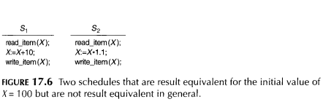
Result Equivalent Schedule

Slide 43
View Equivalent Schedules
Two schedules S₁ and S₂ are view equivalent if transactions in both schedules perform similar actions in similar manner.
For every data item X, if T_{i} reads initial value of X in S₁ then T_{i} must also read initial value of X in S₂
For every data item X, if T_{i} reads value written by T_{j} in S₁ then T_{i} must also read value written by T_{j} in S₂
For every data item X, if T_{i} performs final write on the data value in S₁ then T_{i} must also perform final write on data value in S₂

Slide 44
Consider the following schedules
Schedule P: R₁(x), R₂(y),W₁(x),R₃(x),W₃(x),R₁(y),W₁(y)
Schedule Q: R₂(y), R₁(x),W₁(x),R₃(x),R₁(y),W₃(x),W₁(y)
In the above example, schedule P and Q are view equivalent because in both schedules initial value of x is read by T₁ and initial value of y is read by T₂.
Similarly T₃ reads value of x that is written by T₁
And finally T₃ writes final value of x and t₁ writes final value of Y

Slide 45
Conflict Equivalent Schedules
Two schedules are said to be conflict equivalent if the order of any two conflicting operations is the same in both schedules.
If two conflicting operations are applied in different orders in two schedules, the effect can be different on the database or on other transactions in the schedule and hence the schedules are not conflict equivalent.

Slide 46
Conflict Equivalent Schedules
Using the notation of conflict equivalence, we define a schedule S to be conflict serializable it is (conflict) equivalent to some serial schedule S’. In such a case, we can reorder the nonconflicting operations in S until we form the equivalent serial schedule S’

Slide 47
Serializability
When several concurrent transactions are trying to access the same data item, the instructions within these concurrent transactions must be ordered in some way so as there are no problems in accessing and releasing the shared data item.
We can ensure consistency of the database under concurrent execution by making sure that any schedule that is executed has the same effect as a schedule that could have occurred without any concurrent execution. That concurrent (non-serial) schedule is called serializable schedule.

Slide 48
Serializability
A given non-serial schedule of n transactions is serializable if it is equivalent to some serial schedule.
That is, if a non-serial schedule produce the same result as of the serial schedule then the non serial schedule is said to be serializable.
A schedule that is not serializable is called non-serializable schedule.
The main objective of Serializability is to search non-serial schedules that allow transaction to execute concurrently without interfering one another transaction and produce the result that could be produced by a serial execution

Slide 49
Serializability
There are n! possible serial schedules of n transactions and many more possible non-serial schedules.
We can form two disjoint groups of the non-serial schedules those that are equivalent to one or more of the serial schedules and hence are serializable.
Different forms of schedule equivalence give rise to the notions of : Conflict Serializability and view Serializability

Slide 50
Conflict Serializability
The definition of conflict Serializability is that a schedule is conflict-serializable if and only if its precedence graph/serializability graph, when only committed transactions are considered, is acyclic.
Consider the following schedules.

Slide 51
T₁ | T₂
Read(X)
Write(Y)
Commit
 | Read(X)
 | Write(Y)
 | Commit
Schedule 1: Serial Schedule <T1,T2>
T₁ | T₂
 | Read(X)
 | Write(X)
 | Commit
Read(X)
Write(Y)
Commit
Schedule 2: Serial Schedule <T2,T1>
T₁ | T₂
Read(X)
 | Read(X)
Write(Y)
Commit
 | Write(Y)
 | commit
Schedule 3: Non-serial Schedule
T₁ | T₂
 | Read(X)
 | Write(X)
Read(X)
 | Commit
Write(Y)
Commit
Schedule 4: Non-serial Schedule

Slide 52
Conflict Serializability
In the above table, non-serial schedule 3 is serializable because it is conflict equivalent to serial schedule 1.
Again, non-serial schedule 4 is also serializable because it is conflict equivalent to any serial schedule 2

Slide 53
Testing for Conflict Serializability of a Schedule
Schedule compliance with conflict Serializability can be tested with the precedence graph (Serializability or conflict graph).
Precedence graph is the directed graph representing precedence of transactions in the schedule, as reflected by precedence of conflicting operations in the transactions.
In the precedence graph transactions are nodes and precedence relations are directed edges.
There exists an edge from a first transaction to a second transaction, if the second transaction is in conflict with the first.
A schedule is conflict serializable if and only if its precedence graph is acyclic

Slide 54
Algorithm testing Serializability of a schedule S
For each transaction T_{i} participating in schedule S, create a node labeled T_{i} in the precedence graph.
Create a directed edge, T_{i}→T_{j}, if T_{j} reads a value of an item written by T_{i}.
Create a directed edge, T_{i}→T_{j}, if T_{j} writes a value of an item after it has been read by T_{i}
Create a directed edge, T_{i}→T_{j}, if T_{j} writes a value of an item written by T_{i}.
Test the precedence graph for existence of cycle. If cycle is encountered, schedule is not serializable. Otherwise schedule is serializable.

Slide 55
Example 1: Draw precedence graph for following schedule and identify whether it is conflict serializable or not. If it is conflict serializable, identify equivalent serial schedule also.
Schedule H: R₂(x), W₂(x), R₁(x), W₁(x), R₂(y),R₃(x), W₂(y), W₃(x)
Solution:
T₁ | T₂ | T₃
 | read(X)
 | Write(X)
Read(x)
Write(x)
 | Write(y)
 |  | Read(x)
 | Write(y)
 |  | Write(X)
T₁
T₂
T₃

Slide 56
Precedence graph for above schedule
Figure: Precedence Graph for schedule H
Since, above precedence graph of the schedule H, with 3 transactions does not contain cycle. The given schedule H is conflict serializable.
The equivalent serial schedule can be achieved if transaction operations are taken in order T₂→T₁→T₃.
This equivalent serial schedule is:
R₂(x),W₂(x),R₂(y),W₂(y),R₁(x),W₁(x),R₃(x),W₃(x)
T₁
T₂
T₃

Slide 57
Example 2: Consider the following schedule
S: R₃(A) R₂(A)W₃(A)R₁(A)W₁(A)
Give the precedence graph P(s)
Is the schedule conflict serializable? If so, give all equivalent serial schedules.

Slide 58
Precedence graph for above schedule
T₁ | T₂ | T₃
 |  | Read(A)
 | Read(A)
 |  | Write(A)
Read(A)
Write(A)
 | Table: Schedule S in tabular form
T₁
T₂
T₃
Figure: Precedence Graph for Schedule S

Slide 59
Since the above precedence graph is not cyclic hence given schedule is conflict serializable.
And its equivalent schedule is T₂→T₃→T₁.
In tabular form the equivalent schedule can be written as:
T₁ | T₂ | T₃
 | Read(A)
 | Write(A)
 |  | Read(A)
 |  | Write(A)
Read(A)
Table: Serial Schedule

Slide 60
Example 3
Consider the following schedule S’ = W₁(A)R₂(A)W₃(B)W₁(B)W₃(B)W₂(A)R₃(B)R₂(B)
Give the precedence graph P(s)
Is the schedule conflict serializable? If so, give all equivalent serial schedules

Slide 61
Solution
T₁ | T₂ | T₃
Write(A)
 | Read(A)
 |  | Write(B)
Write(B)
 |  | Write(B)
 | write(A)
 |  | Read(B)
 | Read(B)
Table: Schedule S in tabular form
T₁
T₂
T₃
Figure: Precedence Graph for Schedule S

Slide 62
Since the above precedence graph is cyclic hence given schedule is not conflict serializable. And its serial schedule cannot be determined

Slide 63
View Serializability
Definition of view Selializability based on view equivalence. S schedule is view serializable if it is view equivalent to some serial schedule. Every conflict serializable schedule is also view serializable; however some view serializable schedules are not conflict serializable.
Two schedules S and S’ consisting of the same operations from n transactions T₁, T₂,… T_{n} are view equivalent if the following three conditions are hold.
1. For each data item X, if transaction T_{i} reads the initial value of X in schedule S, then Transaction T_{i} must also read the initial value of X in schedule S’

Slide 64
View Serializability
2.For each read operation on data item X by transaction T_{i} in schedule S, if the value read by T_{i} has been written by transaction T_{j}, then transaction T_{i} must also read the value of X produced by transaction T_{j} in the schedule S’.
3. For each data item X, if the last write operation on X was performed by transaction T_{i} in schedule S, the same transaction T_{i} must perform the final write on data item X in schedule S’.

Slide 65
View Serializability
T₃ | T₄ | T₅
read(X)
 | write(X)
write(x)
 |  | write(X)
T₃ | T₄ | T₅
read(X)
write(X)
 | write(X)
 |  | write(X)
Figure: Schedule 1
Figure: Schedule 2

Slide 66
Testing for Conflict Serializability
The precedence graph test for conflict Serializability can not be used directly to test for view Serializability.
Testing for view Serializability is much more complex than testing for conflict Serializability.
In fact it has been shown that testing for view Serializability is NP –complete, it is highly improbable that an efficient algorithm can be found.

Slide 67
Characterizing Schedules Based on Recoverability
For some schedules it is easy to recover from transaction failures, whereas for other schedules the recovery process can be quite involved.
In some cases, it is even not possible to recover correctly after a failure.
Hence, it is important to characterize the types of schedules for which recovery is possible, as well as those for which recovery is relatively simple and for which recovery is not possible.
These characterizations do not actually provide the recovery algorithm but instead only attempt to theoretically characterize the different types of schedules.

Slide 68
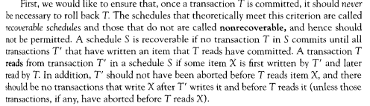
Characterizing Schedules Based on Recoverability

Slide 69
Cascadeless Schedules
Even if a schedule is recoverable, to recover from the failure of a transaction T_{i}, we may have to roll back several transactions. Such situations occur when transactions have read data written by T_{i}.
Consider the partial schedule containing transaction T₁₀, T₁₁, and T₁₂. Transaction T₁₀ writes a value of A that is read by transaction T₁₁. Transaction T₁₁ writes a value of A that is read by transaction T₁₂. Suppose that at this point, T₁₀ fails. T₁₀ must be rolled back. Since T₁₁ is dependent on T₁₀, T₁₁ must be rolled back. Since T₁₂ is dependent on T₁₁, T₁₂ must be rolled back. This phenomenon, in which a single transaction failure leads to a series of transaction rollback, is called cascading rollback.

Slide 70
Cascadeless Schedules
T₁₀ | T₁₁ | T₁₂
Read(A)
read(B)
Write(A)
 | Read(A)
 | Write(A)
 |  | Read(A)
T₁₆ | T₁₇
read(A)
Write(A)
commit
 | Read(A)
 | Write(A)
 | Commit
Figure: Schedule11
Figure: Schedule 12- Cascadeless Schedule

Slide 71
Cascadeless Schedules
Cascading rollback is undesirable, since it leads to the undoing of a significant amount of work. It desirable to restrict the schedules to those where cascading rollback cannot occur. Such schedules are called Cascadeless schedules.
Formally, a cascadeless schedule is one where, for each pair of transaction T_{i} and T_{j} such T_{j} reads a data item previously written by T_{i}, the commit operation of T_{i} appears before the read operation of T_{j}. It is easy to verify that every cascadeless schedules is also recoverable.

